Slide 1
733 - DATA MINING ASSIGNMENT 1
Group Members :
Sakshi Menghani
Neil Kamlesh Advani
Vidhi Panchal
Lassaya

Slide 2
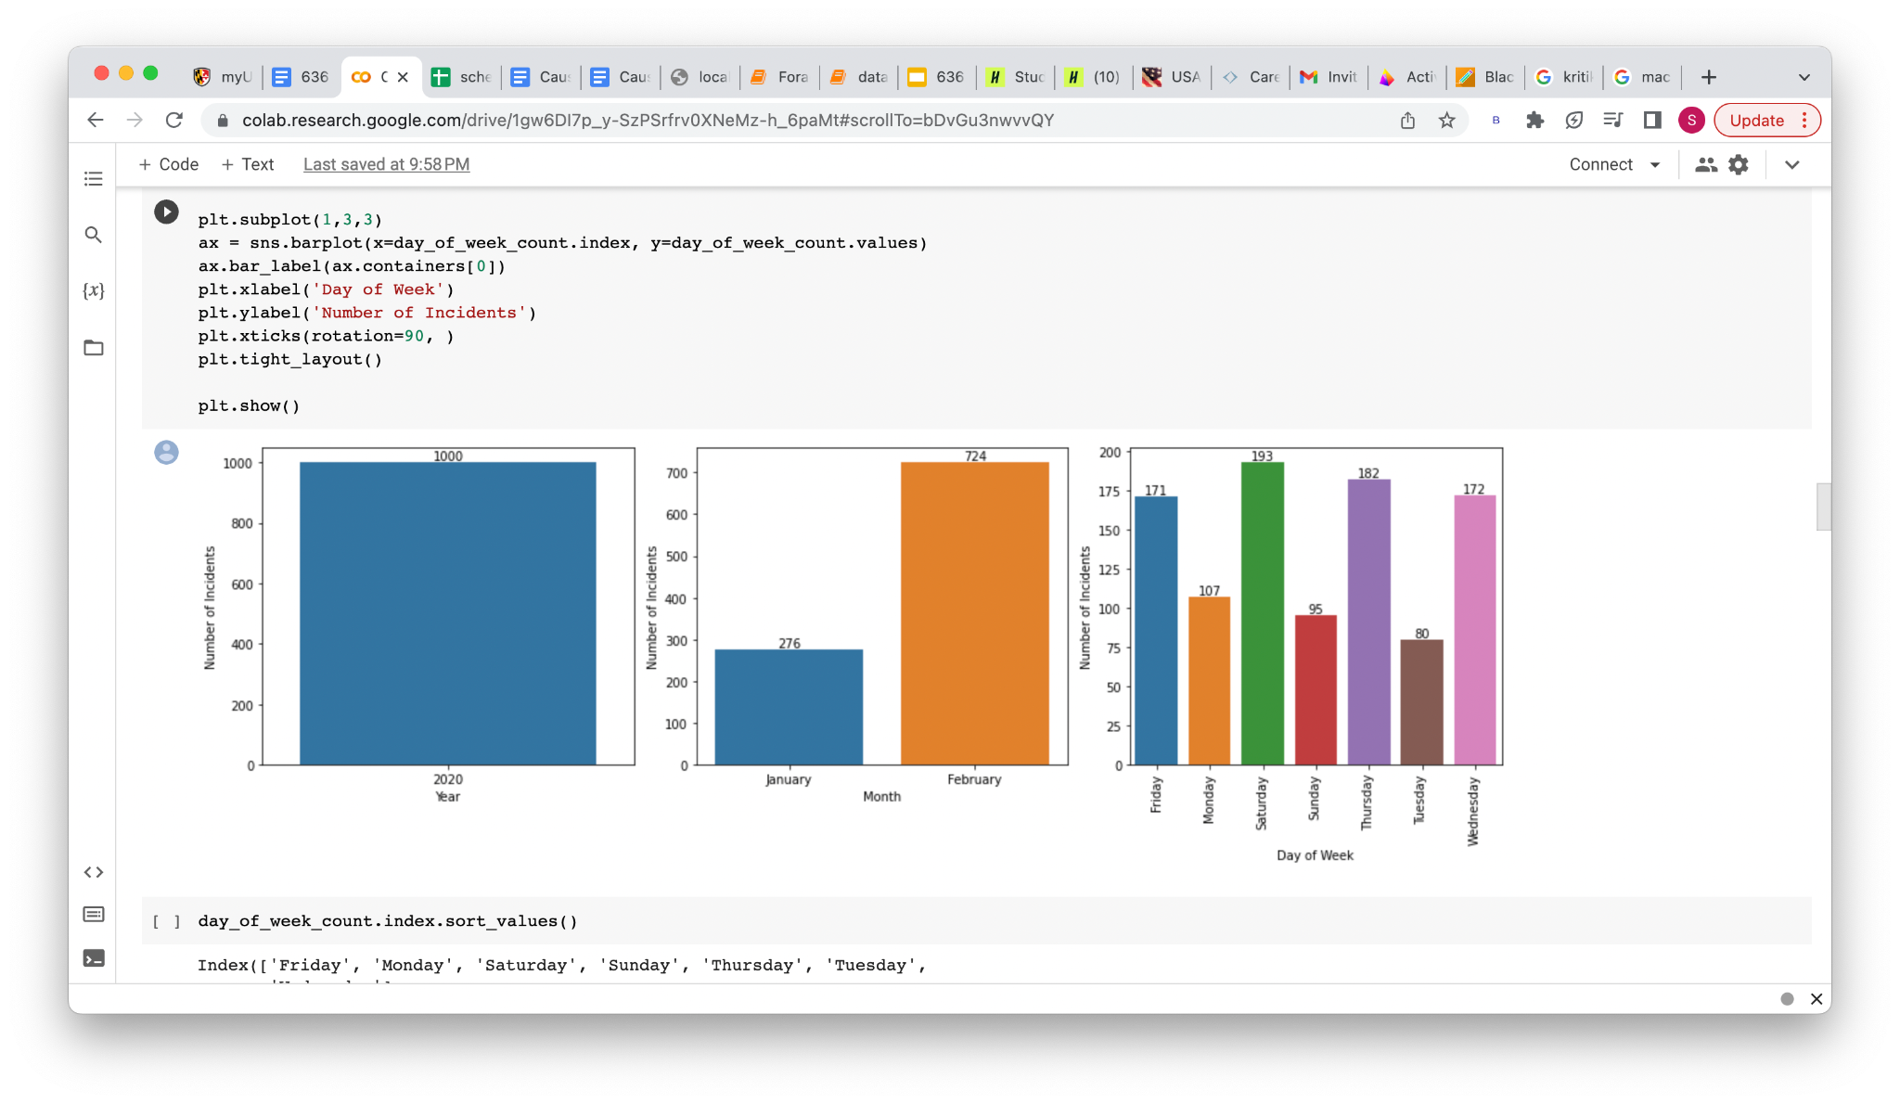
Overall crime incidents over all geo-locations

Slide 3
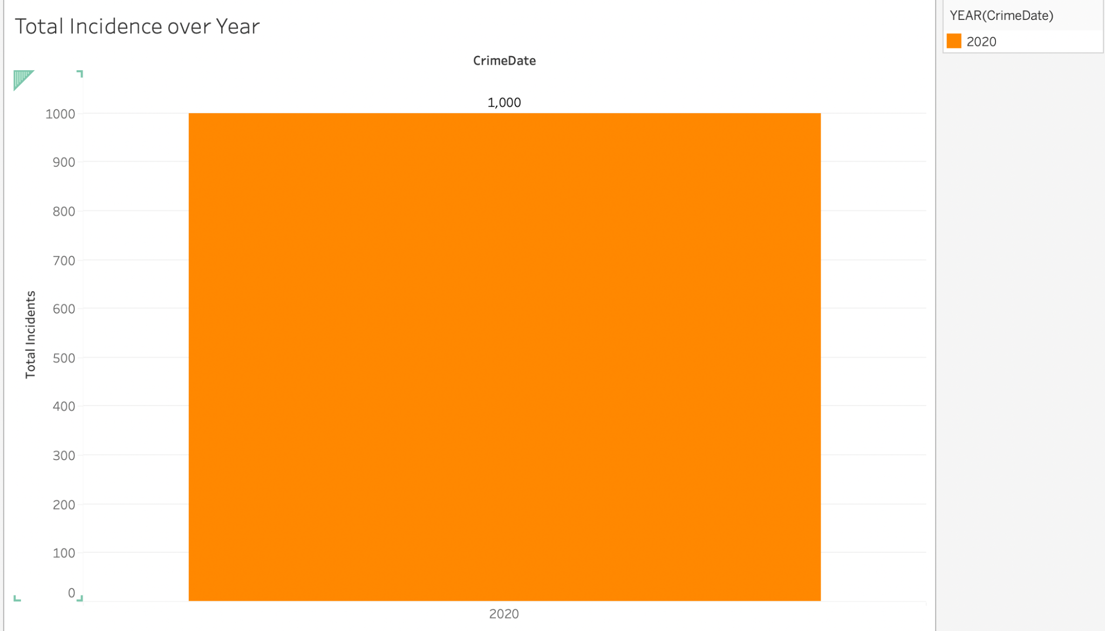
Total Crime incidents in the year 2020
Following graph represents 1000 crime incidents in the year 2020

Slide 4
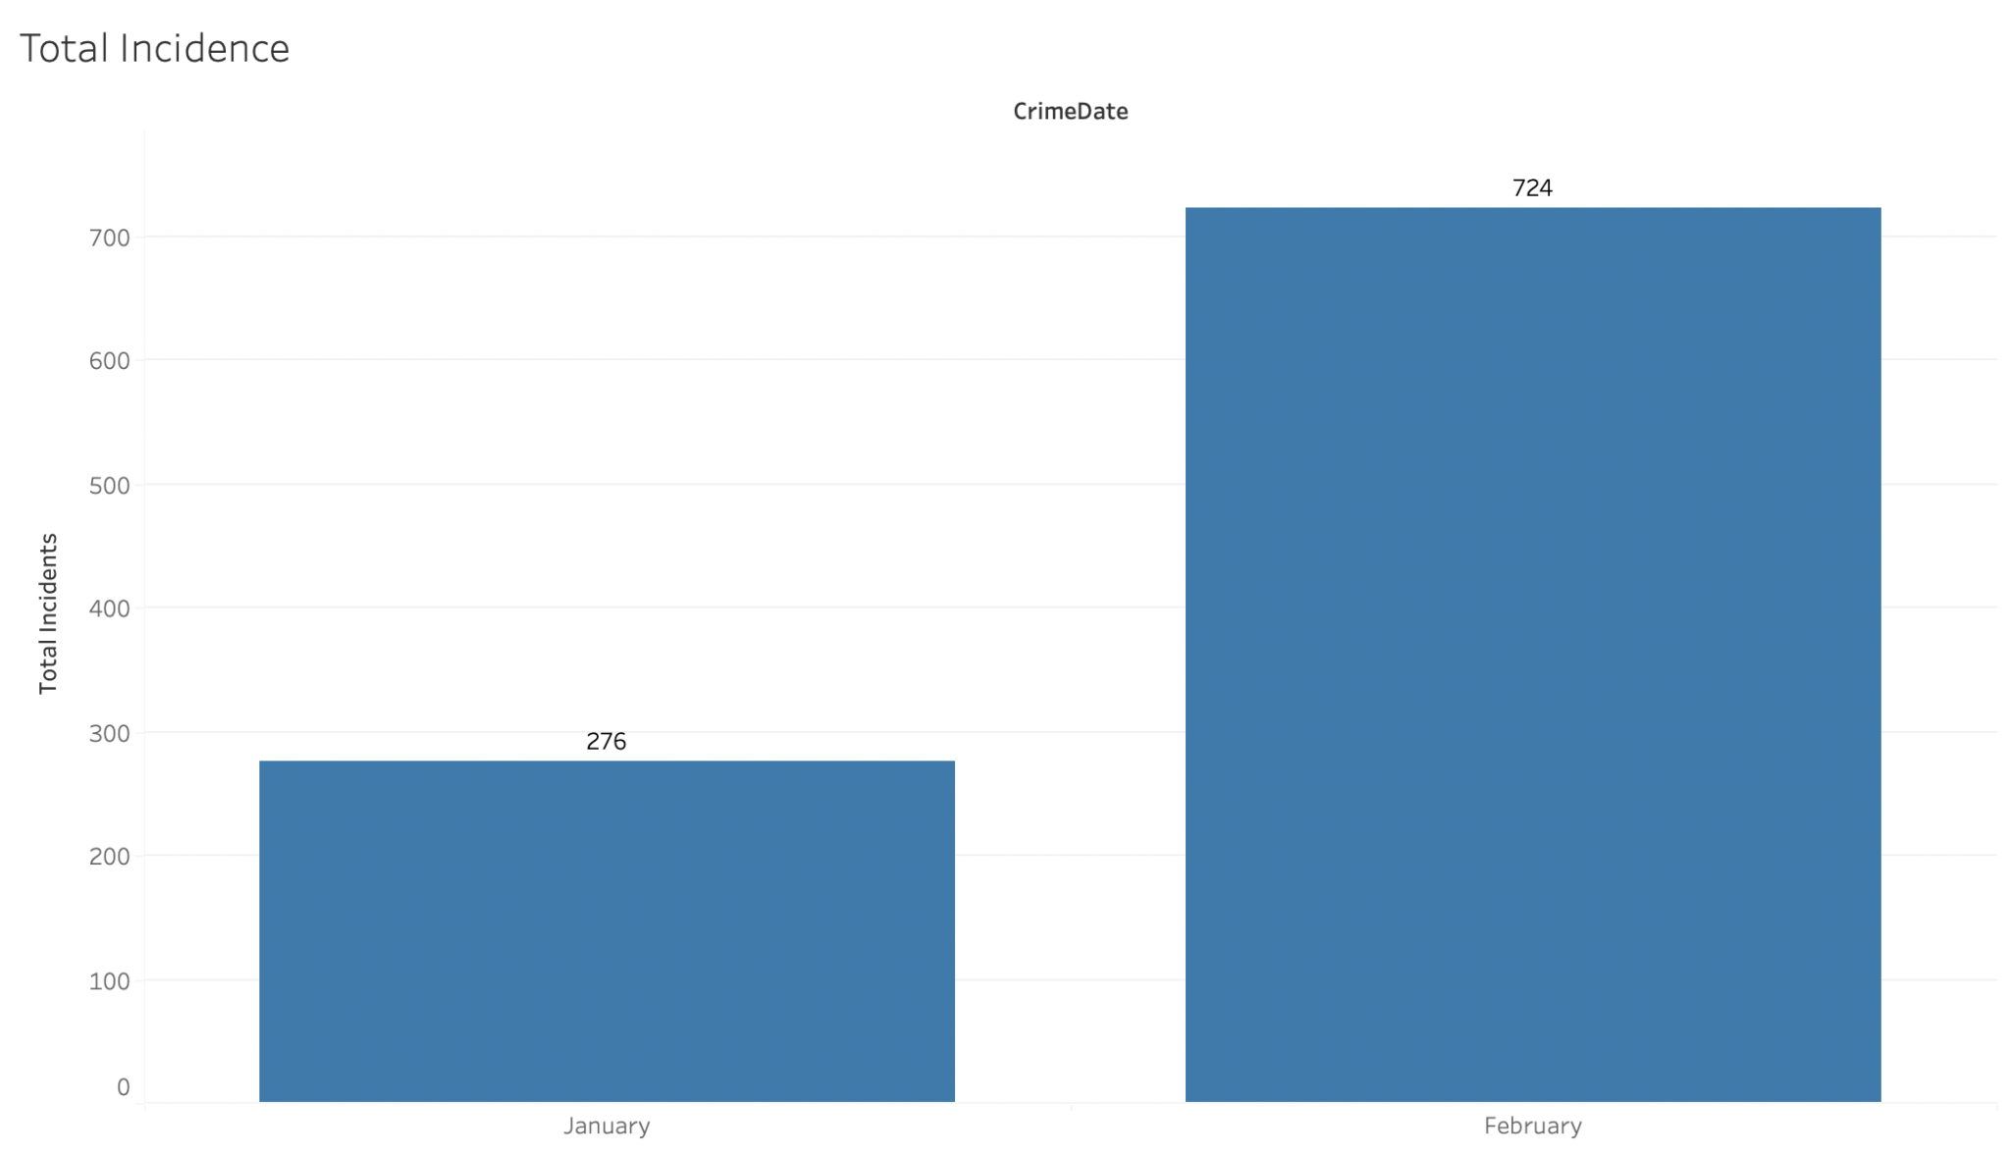
Distribution of total crime incidents over months
Following graph represents 276 incidents in January and 724 incidents in February

Slide 5
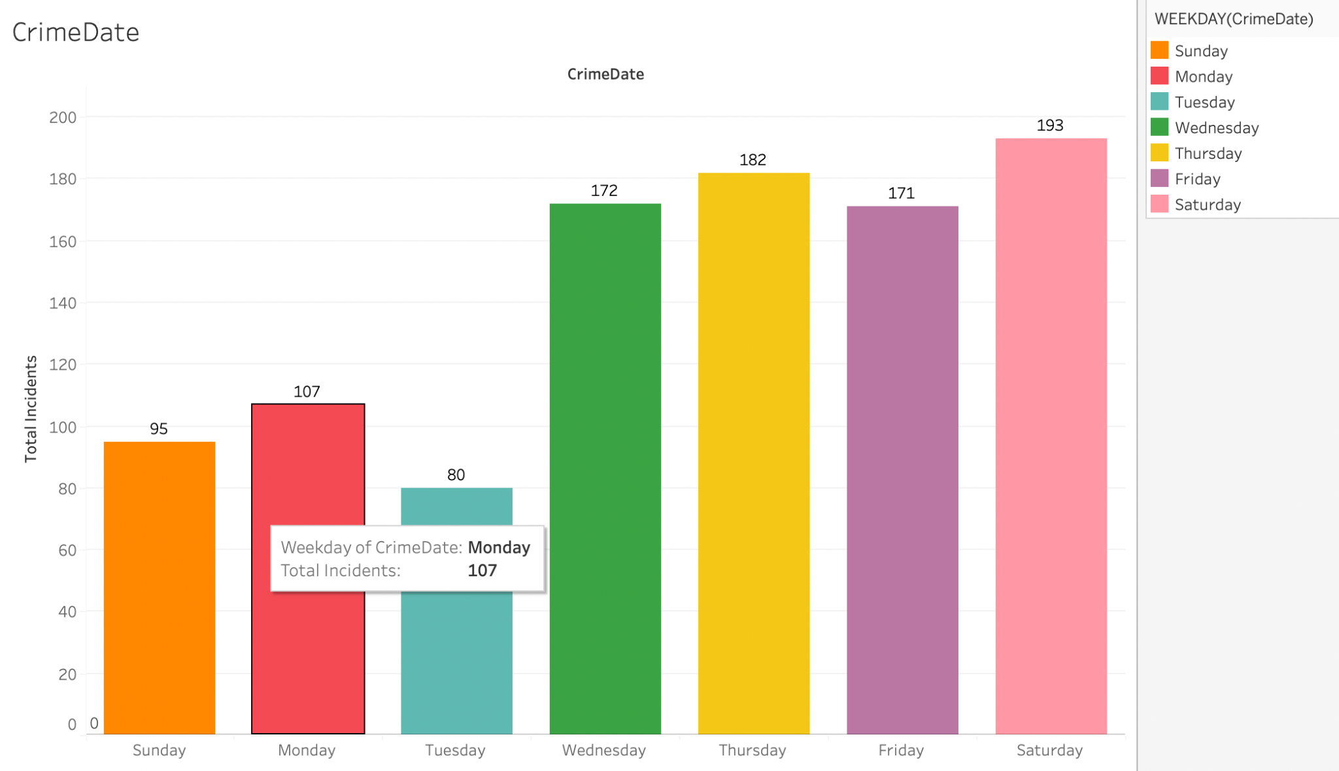
Distribution of Total Crime Incidents over a week Following graph represents the highest and lowest incidents by week
Following

Slide 6
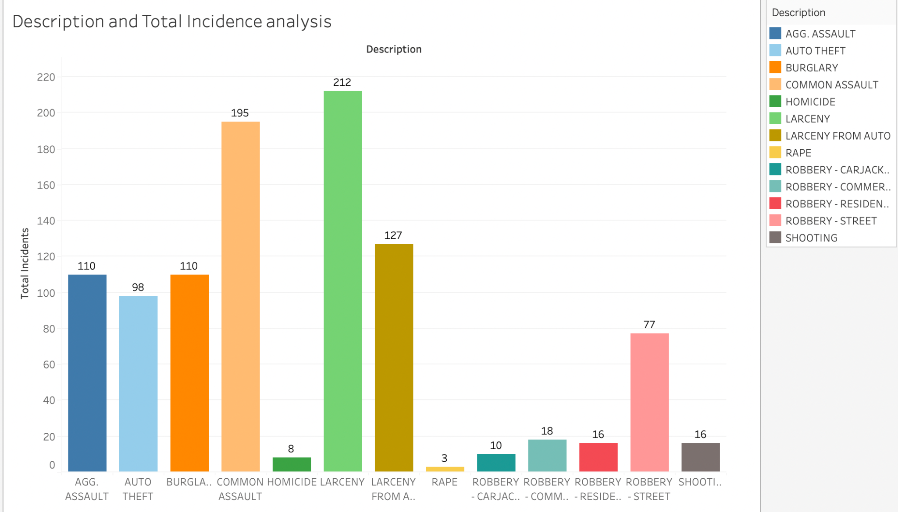
Following graph represents total number of Crime Types in a year highest and lowest number of crime types can be seen

Slide 7
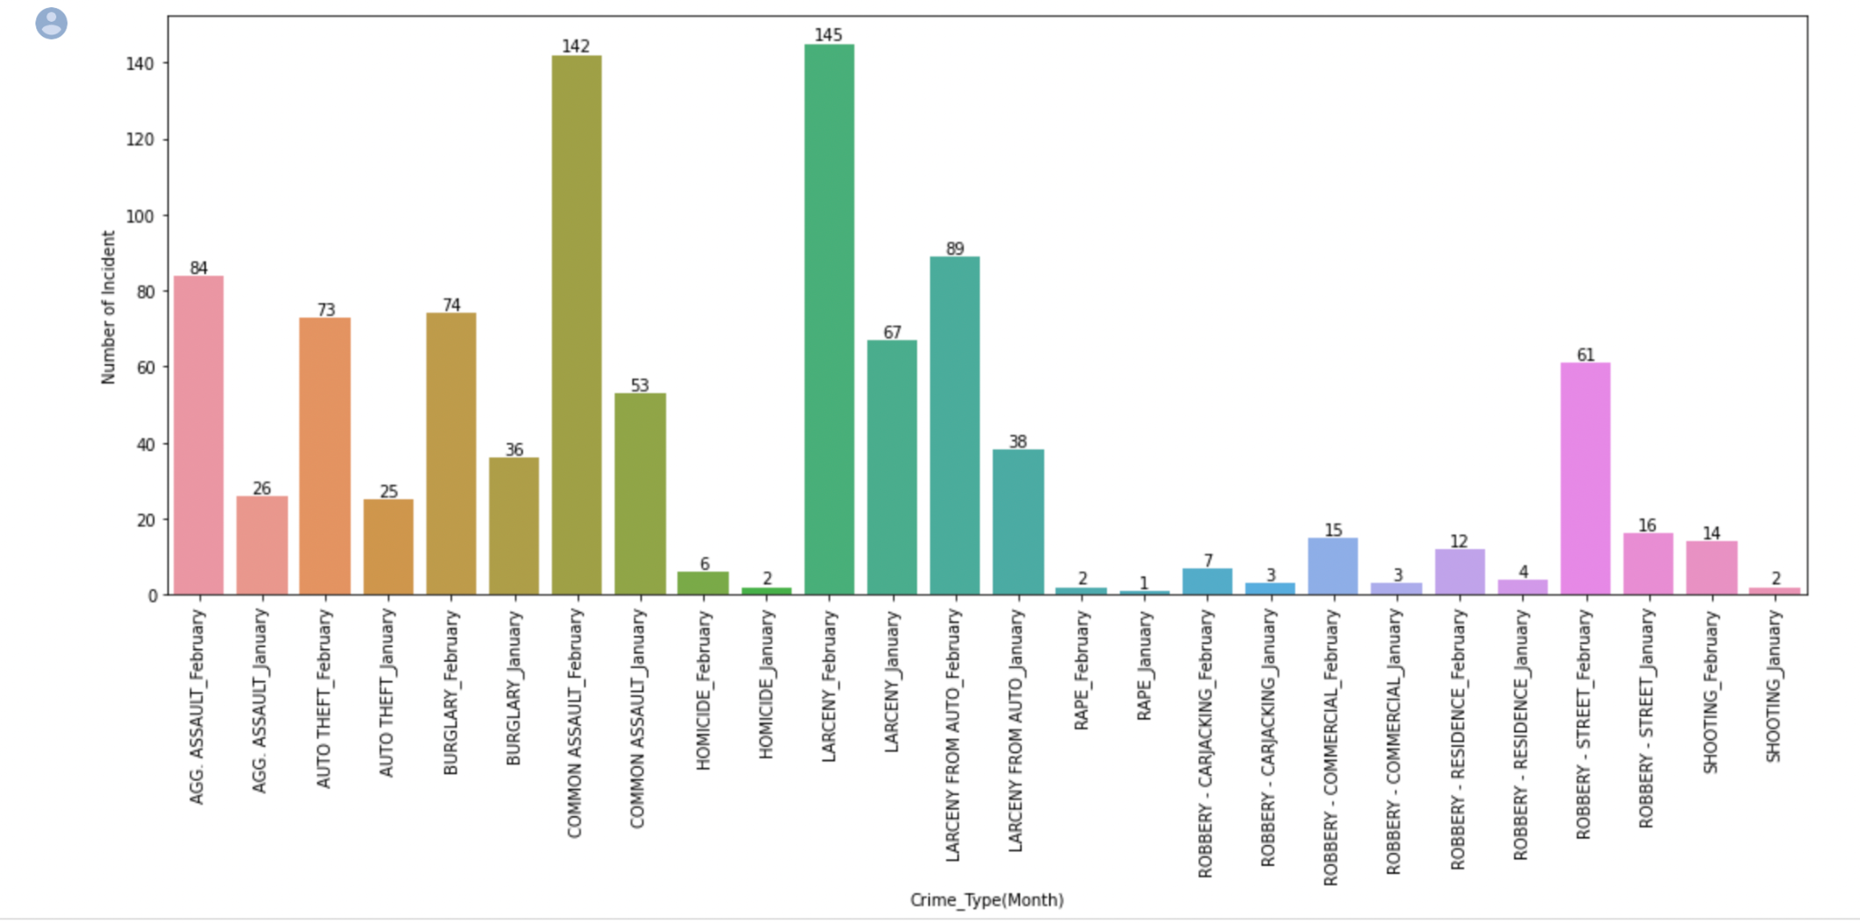
Following graph represents the total number of Crime Types over Months

Slide 8
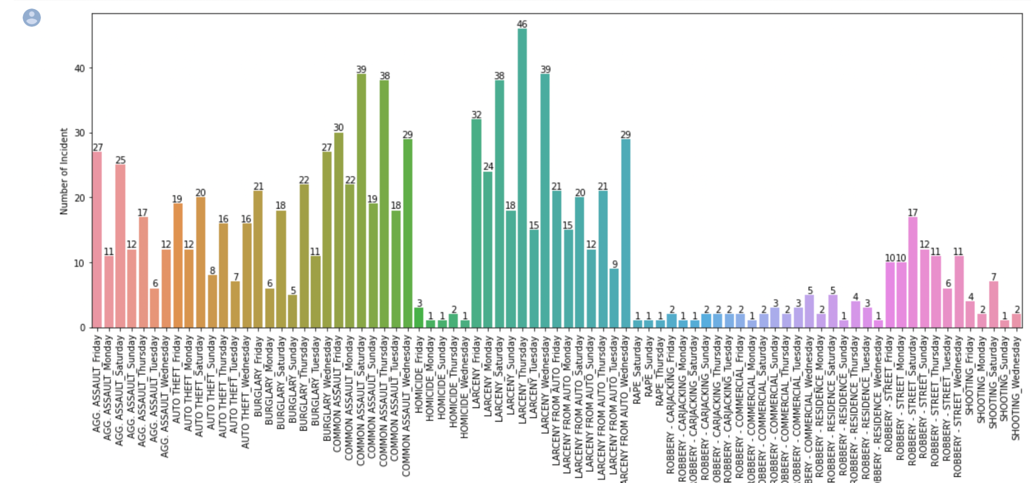
Following graph represents the distribution of different types of crimes over Day-of-Week

Slide 9
Tableau Dashboard Link
https://drive.google.com/file/d/1ql0Ey9i8KAt-j75U3r5Hn3CHizv_E32I/view?usp=drivesdk

Slide 10
Summary
Visualization and dynamic dashboards are powerful tools that help us make sense of complex datasets and communicate insights more effectively. Here are some benefits of visualization and dynamic dashboards: 1. Provides a clear understanding of data: Visualization makes it easier to understand complex datasets and identify patterns, trends, and outliers. 2. Improves decision-making: With a clear understanding of the data, decision-makers can make informed decisions more quickly. 3. Enables real-time monitoring: Dynamic dashboards allow for real-time monitoring of key performance indicators, enabling teams to quickly identify and respond to changes in data. 4. The interesting fact about the design of dashboard is that the each and every visualization is so detailed that for instance, finding total number of crime types over a month or finding the highest number of crime happened in a specific week of a month can be seen by interacting accordingly.

